Slide 1
PC Maintenance: Preparing for A+ Certification
Chapter 24: Modems

Slide 2
Chapter 24 Objectives
Understand and change modem communication settings
Explain modem standards
Differentiate between types of modems
Set up DUN connections
Test and troubleshoot modems
Use a terminal application
Use AT commands

Slide 3

Baud Rate and BPS
Baud rate: number of cycles per second
Bits per second (bps) is a multiple of baud rate

Slide 4
UARTs
Universal Asynchronous Receiver/Transmitter
Converts between serial and parallel data
External modem does not need an UART chip because it uses the one in the port to which it is attached

Slide 5
Modem Communication Settings
Data bits
Start bits
Stop bits
Parity bits
Flow control
Error detection and compression

Slide 6
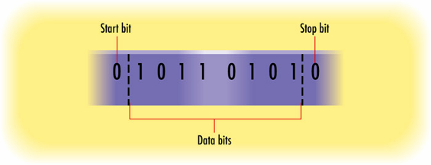
Data Bits, Start Bits, Stop Bits
Each packet contains either 7 or 8 data bits
Leading bit is start bit, always 0
Ending bit is stop bit, always 0, optional

Slide 7
Parity Bits
Can be even parity or odd parity
Count the number of 1s in the data
With even parity:
  If the number is already even, parity bit is set to 0
  If odd, parity bit is set to 1, making the total bit count even
With odd parity, the opposite
With no parity, not done at all

Slide 8
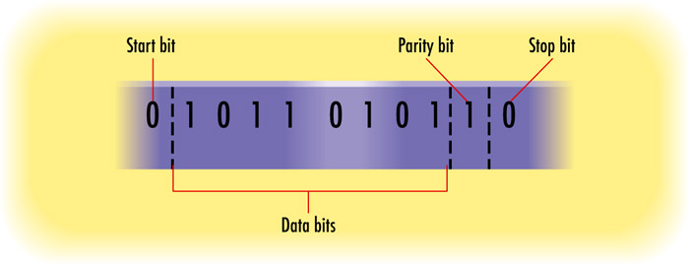
Parity Bits
Example of even parity:

Slide 9
Flow Control
Flow between the modem and the COM port
Mostly an issue with external modems
Hardware type: Ready to Send (RTS) Clear to Send (CTS)
Software-type: XON/XOFF

Slide 10
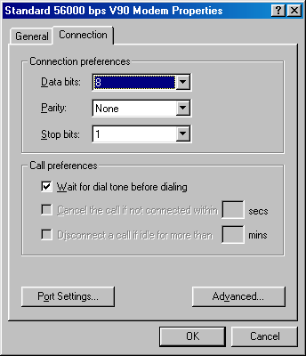
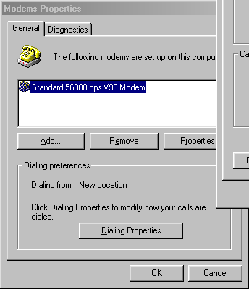
Changing Communications Settings in Windows 9x
From Modems in Control Panel, view modem’s Properties

Slide 11
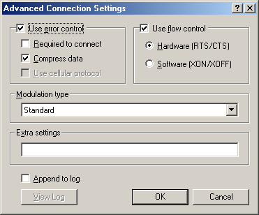
Changing Communications Settings in Windows 9x
To set flow control, click Advanced button to see Advanced Connection Settings

Slide 12
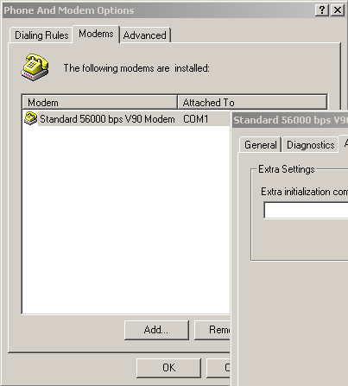
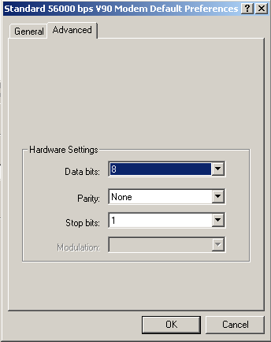
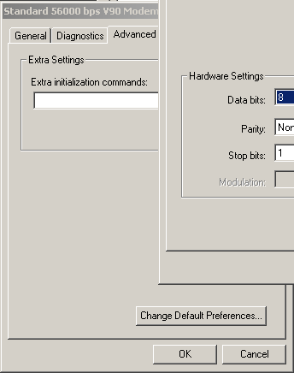
Changing Communications Settings in Windows 2000/XP
From Phone and Modem Options in Control Panel, view modem’s Properties

Slide 13
Modem Standards
V.34: An early modem standard
  28.8Kbps
  Eventually upped to 33.6Kbps
56KFlex and X2
  Two competing standards for 56Kbps
  Eventually merged into the V.90 standard

Slide 14
Modem Standards
V.92
  Current standard for 56Kbps modems
  Like V.90 but with improvements
    QuickConnect
    PCM Upstream
    Modem-on-Hold

Slide 15
Modem Standards
V.42bis and V.44
  Standards for compressing data
  They work alongside V.90 or V.92
  V.44 is the newer standard, with higher compression ratios (20 to 60% higher than V.42bis)

Slide 16
Hardware vs. Software Controlled Modems
Hardware modems
  Have their own controller and BIOS chip
  Do not require a specific OS
  Can be internal or external
  Superior performance
  More expensive
  Not very common anymore (unfortunately)

Slide 17
Hardware vs. Software Controlled Modems
Software modems
  Require Windows-based controller software
  Work only with Windows
  Are always internal
  Are less expensive
  Might not work with some applications that expect a hardware modem

Slide 18
Internal vs. External Modems
Internal
  PCI, ISA, PC Card
  Less expensive
  Require resources directly (IRQ, etc.)
External
  Legacy COM or USB
  More expensive
  Require power connection
  Do not require resources directly (IRQ, etc.)

Slide 19
Fax and Voice Modems
Nearly all modems are fax-capable
  Group 1 and Group 2: 300 bps, now obsolete
  Group 3 : Several standards
    ITU V.27 (4,800 bps)
    ITU V.29 (9,600 bps)
    ITU V.17 (14,400 bps, current standard)
Voice capability (“voice modem”)
  Works with answering machine software

Slide 20
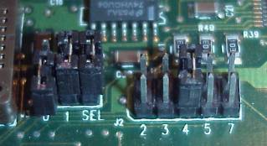
Installing an Internal Modem
Set jumpers on modem to define IRQ (needed only on very old equipment)

Slide 21
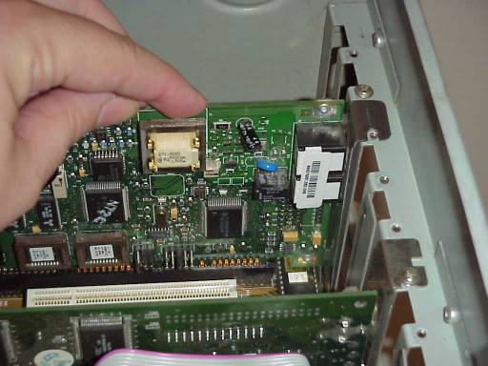
Installing an Internal Modem
Insert into any free slot of the appropriate type
Connect phone line and, optionally, telephone

Slide 22
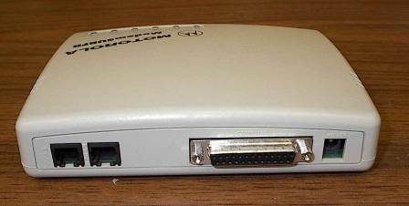
Installing an External Modem
Connect to COM or USB port
Connect to AC power
Attach phone line and, optionally, telephone

Slide 23
Troubleshooting Modem Problems
  Check physical connectivity
  Use Device Manager to check for problems
  Check resource allocations
  Make sure usable driver is installed
  Test with Windows testing utility

Slide 24
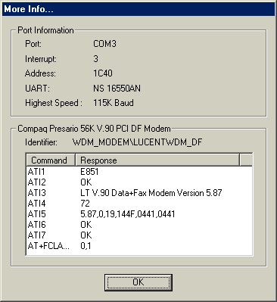
Testing a Modem in Windows 9x
Open Modems from Control Panel
Click Diagnostics tab
Select the modem
Click More Info

Slide 25
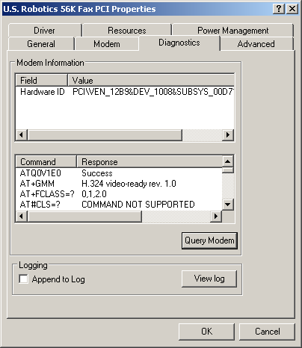
Testing a Modem in Windows 2000/XP
Open Phone and Modem Options from Control Panel
Click the modem
Click Properties
Select Diagnostics tab
Click Query Modem

Slide 26
TAPI Properties
Telephony Application Programmers Interface (TAPI)
  Set of codes that allow programmers to use the modem and phone in applications
  Standard set of TAPI properties in Windows
  User-configurable
  Multiple dialing locations possible

Slide 27
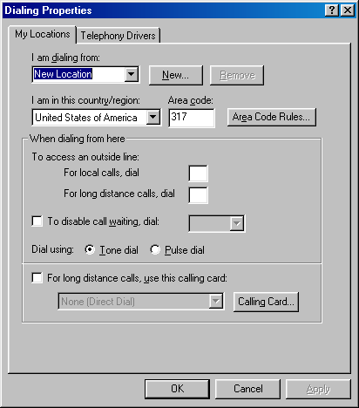
TAPI Properties
Windows 9x: Telephony icon in Control Panel
Click New to create a new dialing location

Slide 28
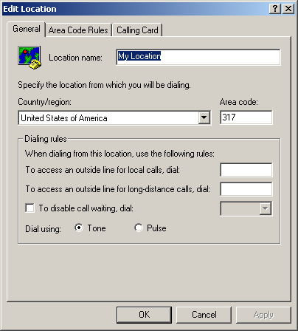
TAPI Properties
Windows 2000/XP: Phone and Modem Options in Control Panel
Dialing Rules tab
Double-click a location to edit its properties

Slide 29
Dial-Up Networking
Direct connection from one computer to another, such as PC to ISP
Requires a modem
Point to Point Protocol (PPP) most common
Serial Line Internet Protocol (SLIP) less common, used for some UNIX servers

Slide 30
Creating a DUN Connection in Windows 9x/Me
Install Dial-Up Networking if needed (Windows component)
Open Dial-Up Networking folder:
  Windows 95/98: choose Dial-Up Networking from My Computer window
  Windows Me: Start > Settings > Dial-Up Networking

Slide 31
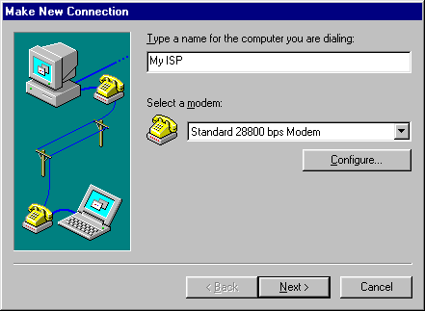
Creating a DUN Connection in Windows 9x/Me
Double-click Make New Connection
Follow the prompts

Slide 32
Internet Connection Wizard
Another way of creating a DUN connection in Windows 98/Me
Specifically for an ISP connection
Start the Wizard:
  Windows 98: Start > Programs > Accessories > Internet Tools > Internet Connection Wizard
  Windows Me: Start > Programs > Accessories > Communications > Internet Connection Wizard
Work through the prompts

Slide 33
Creating a DUN Connection in Windows 2000
Two choices of wizards:
  Network Connection Wizard
    Can be used either for private DUN or for Internet
    If you choose Internet, it closes itself and opens Internet Connection Wizard.
  Internet Connection Wizard

Slide 34
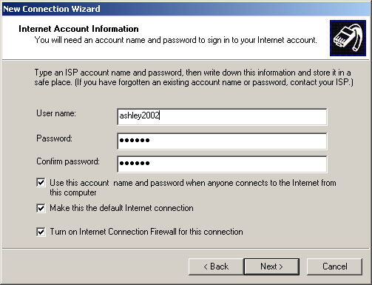
Creating a DUN Connection in Windows XP
Internet Connection Wizard integrated into the New Connection Wizard
Start new Connection Wizard and follow the prompts

Slide 35
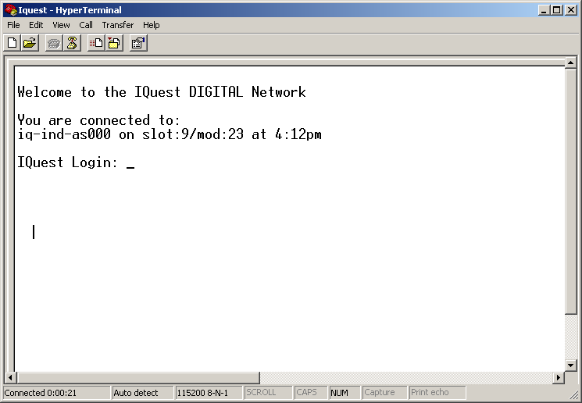
Using a Terminal Program
Direct text-based connection between two PCs
Hyperterminal comes with Windows

Slide 36
Half-Duplex and Full-Duplex
Duplex: ability to send and receive on the same wire
  Half-duplex: Send and receive, but not simultaneously
  Full-duplex: Send and receive simultaneously

Slide 37
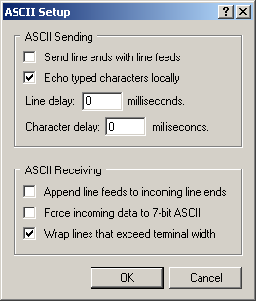
Set Up Duplex in Hyperterminal
Choose File > Properties
On the Settings tab, click ASCII Setup

Slide 38
Binary File Transfer in a Terminal Program
Uses a different protocol from regular ASCII text
Common protocols include
  ZMODEM (best choice)
  YMODEM
  XMODEM
  KERMIT

Slide 39
Using AT Commands
AT command set originally developed by Hayes, a modem manufacturer
Each command line begins with AT for “attention”
Requires terminal program to be in command mode before issuing

Slide 40
Entering AT Commands in Hyperterminal
At Connection Description box, click Cancel
Type ATE1 and press Enter. (You will not see what you typed.)
  E1 is the command to switch to full duplex mode
Now type whatever AT commands are needed

Slide 41
Example AT Commands
ATDT5552311
  AT: Attention
  DT: Dial the following number using Tone dialing
  5552311: Number to dial
ATZ
  AT: Attention
  Z: Reset

Slide 42
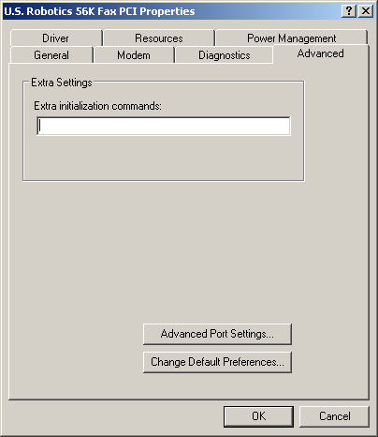
Other Uses for AT Commands
Enter commands in modem’s Properties box

Slide 43
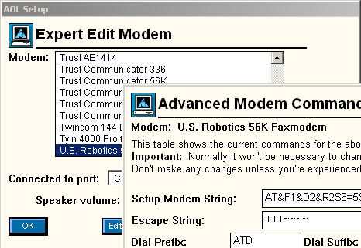
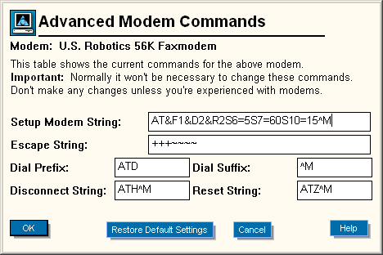
Other Uses for AT Commands
Configure modem settings in AOL

